Slide 1

Event Management
Manage event by us for better arrangements
Submitted by:
Harish Bagde

Slide 2
Introduction to the project
To develop enterprise software that optimizes the performance of an event management company.
The system helps the firm to receive the orders from different clients irrespective of their location.
The System enables even the remote client to make online registrations.
It provides a flexible web outlet to engage more clients in the process of event management process.

Slide 3
features of the project
• Security
• Easy access
• Fast
• Reliable
• Account
• Login

Slide 4
various modules are
Admin
User
Event
Event type
Log in
Registration
Select event

Slide 5

Tools used to develop project
Wamp or Xamp(apache) as web server
Visual Studio Code as editor
Mysql as database

Slide 6
LANGUAGES USED IN PROJECT
HTML4 & HTML5
CSS AND CSS3
PHP (CORE AND ADVANCE)
MYSQL(DATABASE)
JAVASCRIPT

Slide 7
SCREENSHOT

Slide 8
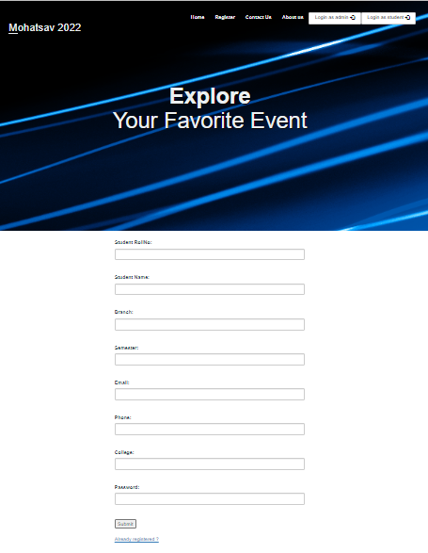
INDEX PAGE

Slide 9
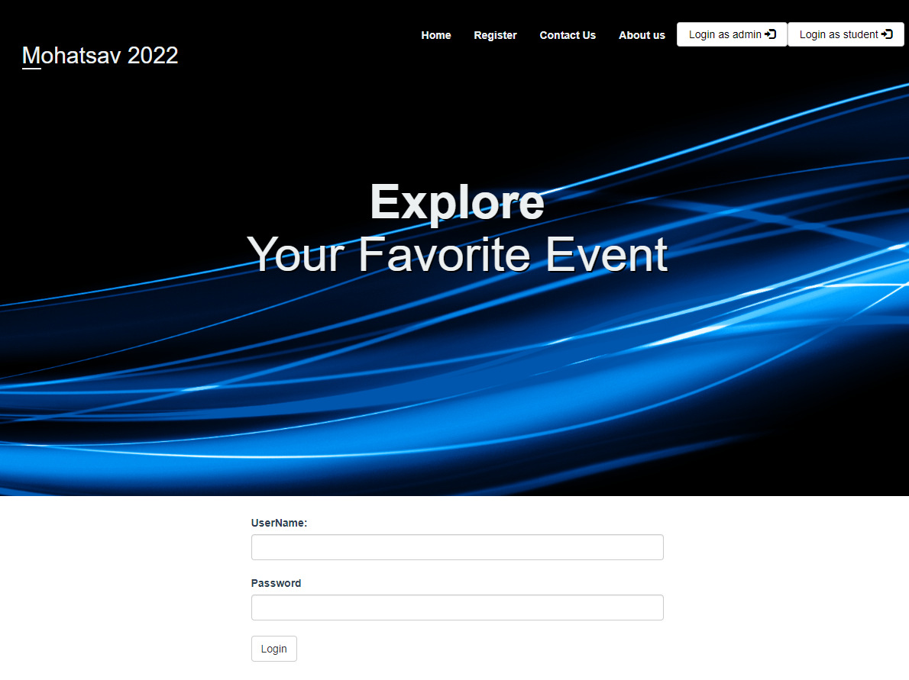
LOGIN

Slide 10
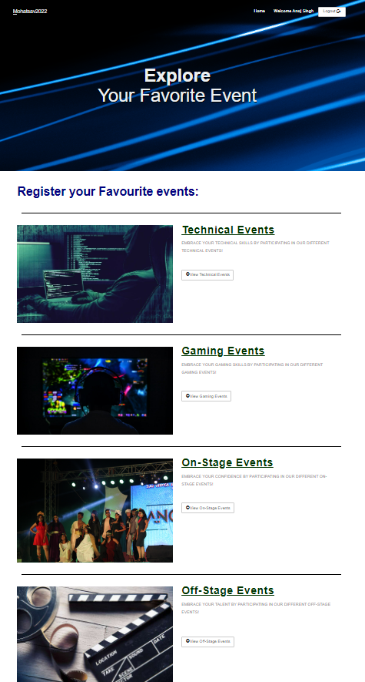
HOME PAGE

Slide 11
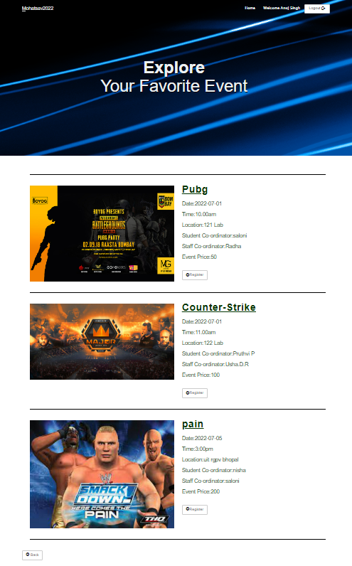
GAMING CATEGORY

Slide 12
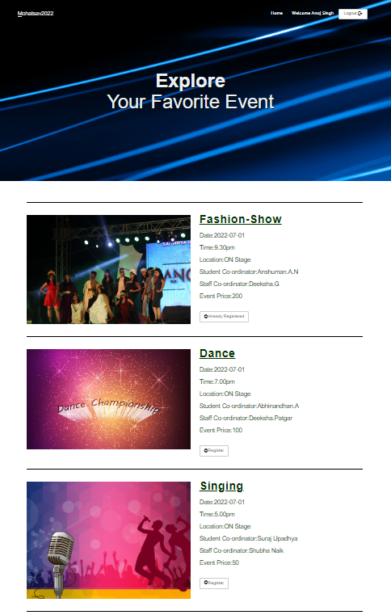
ON STAGE EVENTS

Slide 13

OFF-STAGE EVENTS

Slide 14
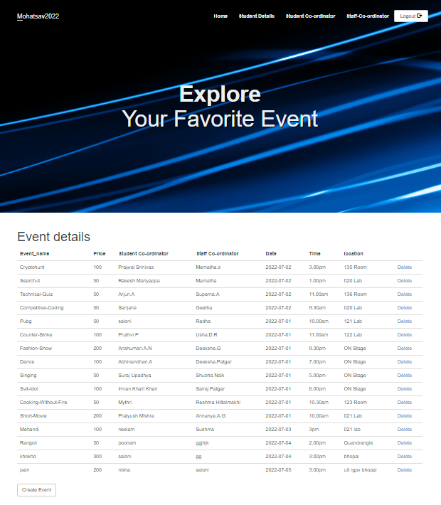
ADMIN PANEL

Slide 15
FLOW CHART

Slide 16
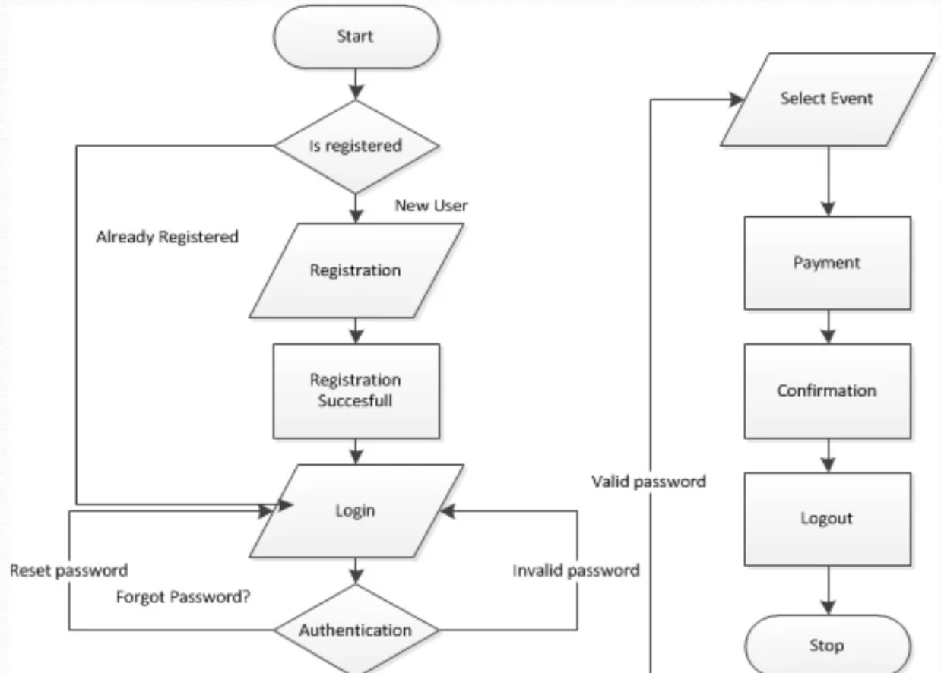

Slide 17
ER DIAGRAM

Slide 18
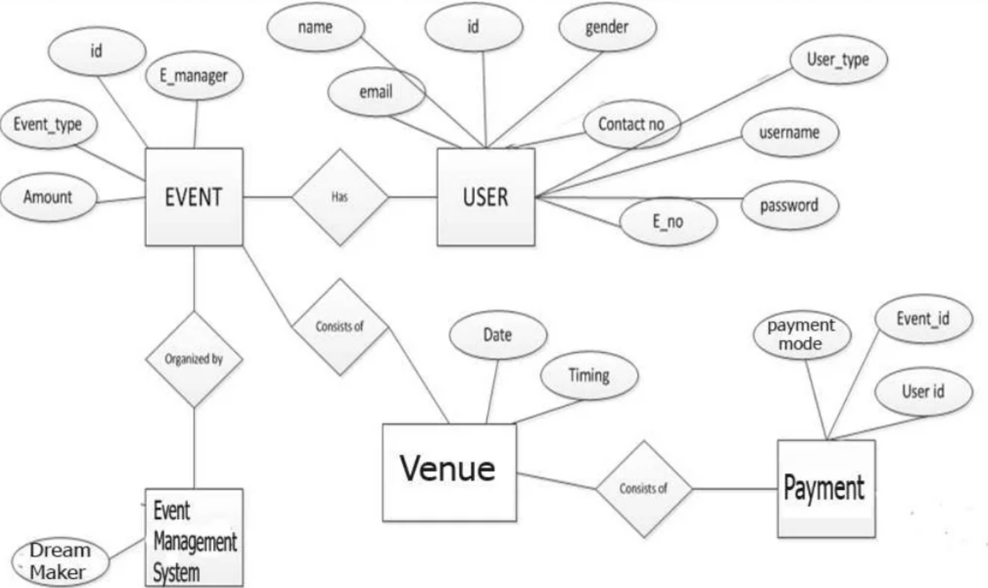

Slide 19
CONCLUSION
Our project is only a humble venture to satisfy the needs to manage their project
work. Several user friendly coding have also adopted. This package shall prove to
be a powerful package in satisfy all requirements of the user. The objective of
software planning is to provide a frame work that enable the manager to make
reasonable estimate made within a limited time frame at the beginning of the
software project and should be update regularly as the project regularly.

Slide 20
THANK YOU

